Slide 1

Skincare product analysis
DECODING THE PRICE OF YOUR SKINCARE PRODUCT
August 2021
Notes:
Only for main study

Slide 2
The frustrated consumer
#F4CBCD
#657338
#C4A27D
#E7CDB2
#E0E0E0
#b4818bff
#f6b1a1ff
#e29699
#6e6976ff
1
Overwhelming amount of choices
“Which product should I choose?”
“Whose recommendation should I go with?”
indecision
disappointment
time
2
Demands value for money
monetary cost
frustration
“Will I get what I paid for?”
”Will it be worth it?”
3
Cost and risk from trial and error
“What if I get an allergic reaction?”
“What if it does not work?”
Notes:
Overwhelming amount of choices can lead to indecision; cost of research for the consumer, harder for brands to differentiate themselves
Demand for value for money – wide range in the prices of products so the search for what is the best product fitting their budget
Cost of trial and error – not just costly in money but also risk on the effect to the face and the length of time it takes to see an effect

Slide 3
Getting insights through machine learning
Identifying determinants of price
Analysing product ingredients
1
What are the possible factors driving up prices?
1
What are the most common ingredients used?
Across various product types, can we identify ‘base formula’ ingredients that are found in majority of the products?
Are products targeting specific skincare concerns generally priced more expensively than others? How about those catering to specific skin types? Is price affected by ratings, number of ratings or likes, or number of reviews?
2
What ingredients tend to be associated with cheap, average and expensive products?
2
What role does branding play in product pricing?
To what extent does branding (i.e. premium market positioning) play in a product’s price? Are there some brands with a stronger or more consistent pricing strategy?
Are certain ingredients more exclusive to the premium category? What chemicals are typically found in the cheaper products?
What products are under- or over-priced?
3
Can we find ‘dupes’? What are the most similar products based on ingredients?
3
Based on what we can learn from how the market prices its products, can we find products that are too expensive or cheaper than what they can be worth?
Looking solely at ingredients, can we spot some potential alternatives to our favorite products? How similar is product A to product B?
#F4CBCD
#657338
#C4A27D
#E7CDB2
#E0E0E0
#b4818bff
#f6b1a1ff
#e29699
#6e6976ff

Slide 4
An overview of the approach
Framing the problem
Jupiter is the biggest of them all
Data collection and wrangling
Deployment
The Earth is where we all live
Data understanding
& preparation
Performance Evaluation
Saturn is composed of hydrogen
Modelling
Mercury is the closest to the Sun
Venus is even hotter than Mercury
#F4CBCD
#657338
#C4A27D
#E7CDB2
#E0E0E0
#b4818bff
#f6b1a1ff
#e29699
#6e6976ff

Slide 5
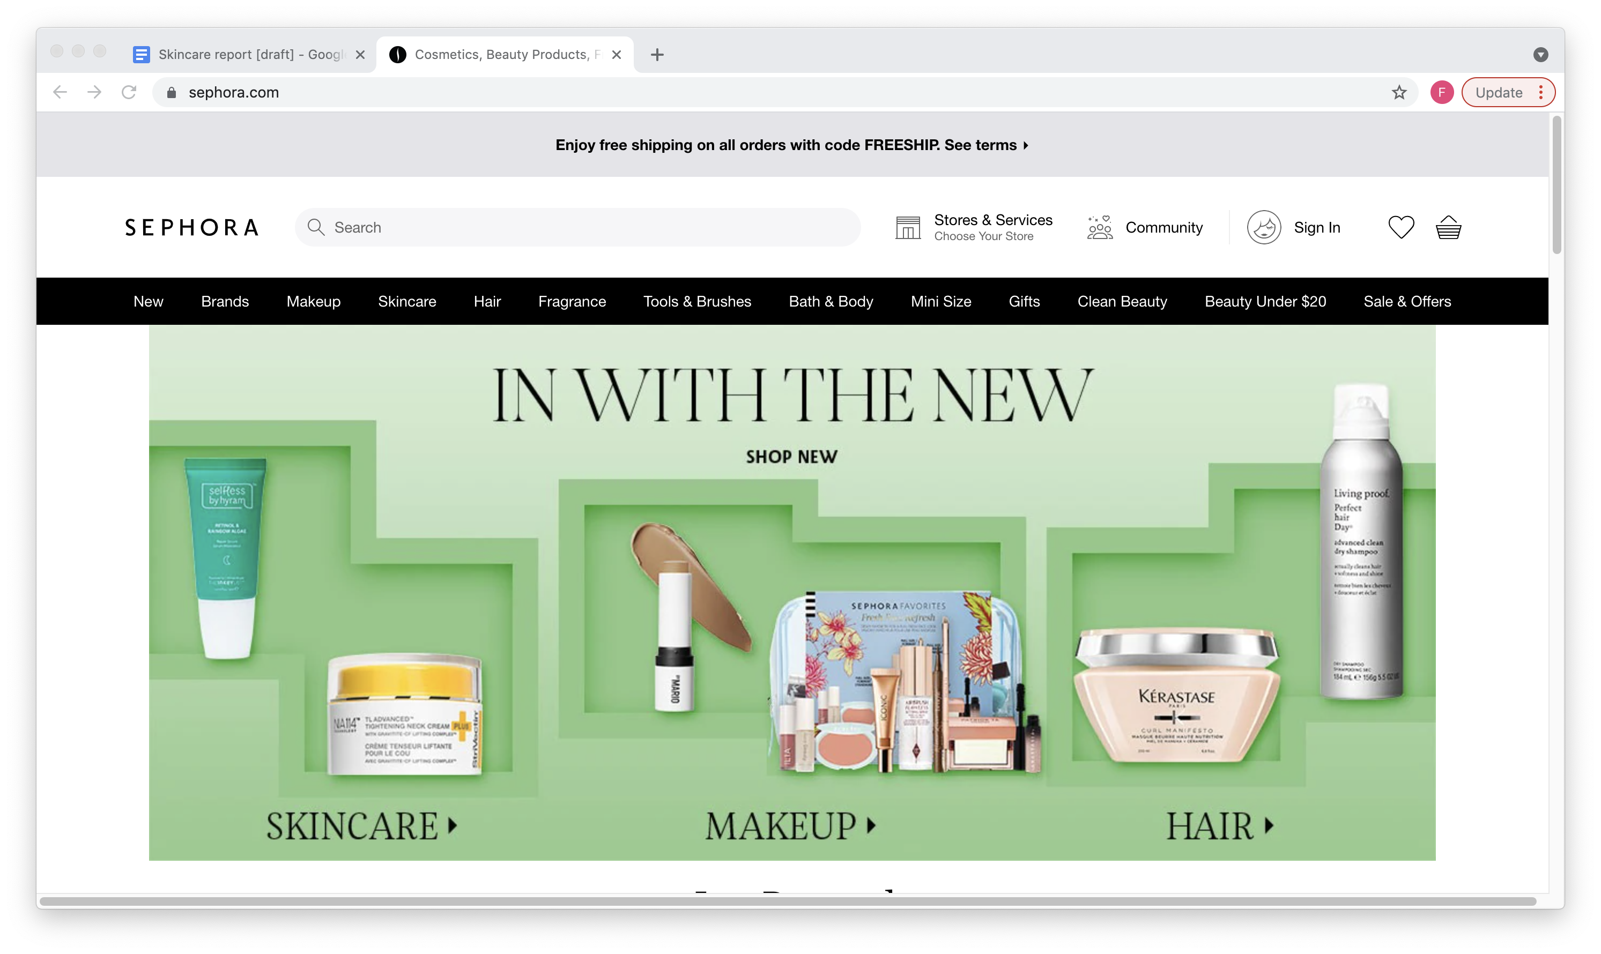
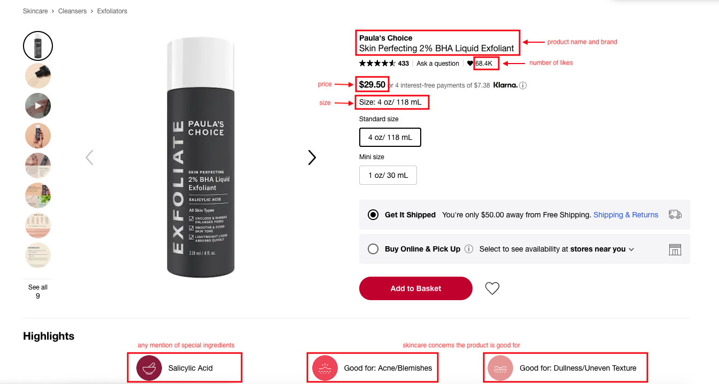

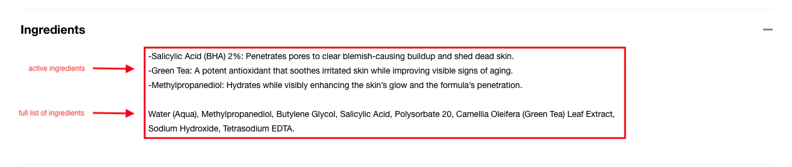
Gathering the data
Requirements
Unique -> own data collection
Extent and variety of product coverage
Richer product information, including possible predictors of pricing
Standardised format
Methodology
Web scraping with Python, Scrapy, Selenium
Dealing with Javascript pages
Overcoming ‘lazy load’
Closing pop-ups

Slide 6
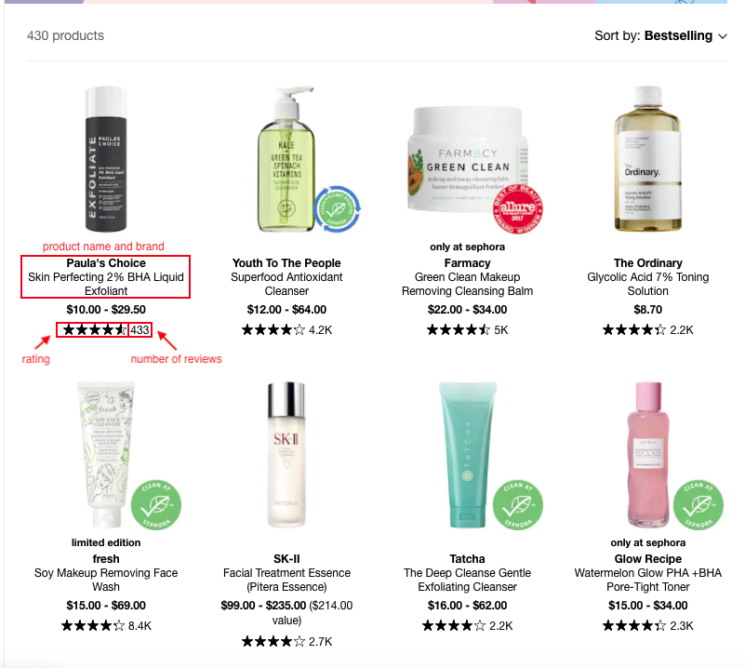
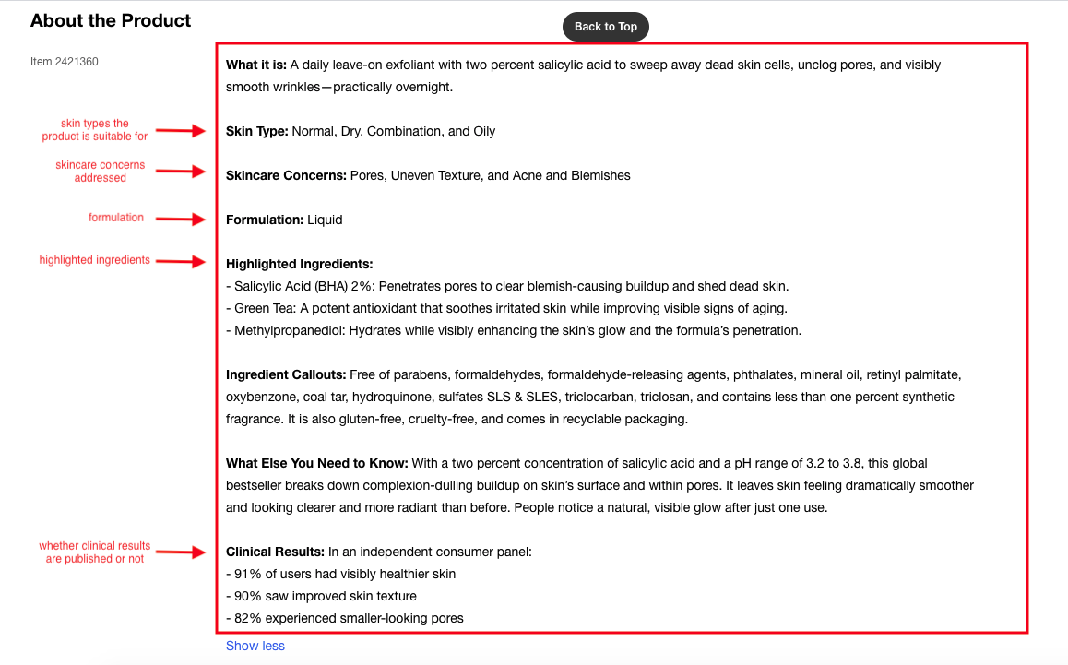
The data collection
1,852 products
4 main categories
from the initial scrape
cleansers, treatments,
eye products, moisturizers
#F4CBCD
#657338
#C4A27D
#E7CDB2
#E0E0E0
#b4818bff
#f6b1a1ff
#e29699
#6e6976ff

Slide 7
The cleaning and preparation of the data
Missing Values
Text pre-processing
Deleted products with no price and size; majority were not the main focus of the study (i.e. supplements, devices, peels, gift sets)
Reduced data set from 1,852 to 1,549 products
Extensive text pre-processing using regex
Used FuzzyMatch to narrow down list of total ingredients from c. 6,000 ingredients to 3,000
Correcting errors manually
Standardising the data format
Upon initial inspection, several entries had to be manually corrected.
Converting number of likes, rating and number of reviews into a standard numeric type after pre-processing (i.e. converting ‘k’ to 1,000, removing ‘stars’ and $)

Slide 8
An overview of the features
Target variable: affordability
’cheap’: under $15 per oz
‘average’: $15 - $56 per oz
‘expensive’: over $56 per oz
Skin care concern(s) addressed
Skin type(s) the product is suitable for
rating
number of likes
number of reviews
awards
general
popularity
branding
targeted problems
formulation
brand
product type
formulation type
richness of formulation
Full ingredient list
Special acids used
Excluded ingredients
inclusion in ‘Clean at Sephora’
vegan product or not
cruelty-free product
publishing of clinical results
#F4CBCD
#657338
#C4A27D
#E7CDB2
#E0E0E0
#b4818bff
#f6b1a1ff
#e29699
#6e6976ff

Slide 9
Feature engineering
Features
Approach
Majority of the features
1
Extract features
List the features for each product
Simplify and combine features
One-hot encoding
Price per volume
Affordability
2
Calculated features
Features include:
Skin concerns, excluded ingredients, skin types addressed, acids used, awards received, formulation type, richness of formula, product category, highlights
Clinical results
Clean at Sephora
Vegan
3
Check for any mention
Binary classification
# of reviews
# of likes
4
Scaling the features

Slide 10
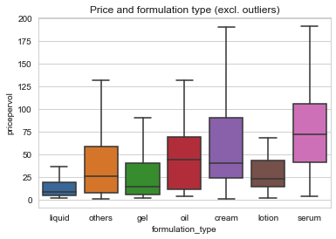
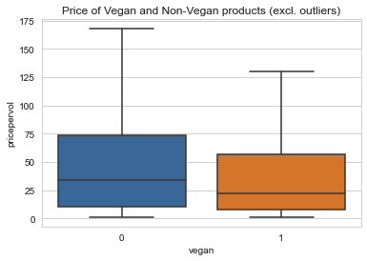
Exploratory data analysis
Pricing by product type
Pricing by formulation type
Pricing for vegan products

Slide 11
Overview of the modelling approach
Use ML for feature selection
Variation of training sets created
Nested cross-validation
GridsearchCV
Random
SearchCV
Gather insights
Retrain w/ optimal parameters
Hyperparameter tuning
5-fold cross validation
Logistic regression
XGBoost
Gradient Boosting
RandomForest
Decision Tree
Support Vector Machine
Compare model performances
6 techniques
Generate base models
Evaluate test set model performance
70:30 split
Train-test split
Retrain on entire dataset

Slide 12
Model performance evaluation*
Metrics
SVM
SVM
Logistic Regression
Logistic Regression
Random Forest
Accuracy:
TP + TN
TP+FP+FN+TN
76.6%
75.4%
75.0%
75.0%
72.1%
Precision:
TP
TP + FP
77.1%
75.8%
75.4%
75.4%
72.3%
Recall:
TP
TP + FN
76.6%
75.5%
75. 0%
75.0%
72.1%
F1 score:
2*recall*precision
recall + precision
76.6%
75.5%
75.0%
75.0%
72.0%
Training set
Features selected using SVM
Full training set
Features selected using SVM
Features selected using logistic regression
Full training set
*Selected results only. Refer to Appedix for a more exhaustive list.

Slide 13
Final model performance on test set
Metrics
Support Vector Machine
XGBoost
Parameter(s): kernel = linear
Parameter(s): min_child_weight = 1, max_depth=6,
gamma=0.3, colsample_bytree=0.3
Accuracy
74.1%
76.1%
F1 score
74.0%
76.0%
ROC-AUC score
80.8%
Cheap: 83.9%
Average: 74.1%
Expensive: 84.4%
82.3%
Cheap: 86.1%
Average: 75.7%
Expensive: 85.0%
 | Predicted
Actual | $ | $$ | $$$
$ | 76% | 18% | 5%
$$ | 13% | 64% | 23%
$$$ | 4% | 13% | 83%
 | Predicted
Actual | $ | $$ | $$$
$ | 79% | 16% | 5%
$$ | 10% | 66% | 24%
$$$ | 2% | 13% | 85%
Confusion Matrix
Training set
Full training dataset
Full training dataset + ingredients

Slide 14
Using the model
How much should it be?
On what basis did it make this prediction?
0.11
0.22
0.67
Cheap
Average
Expensive
No published clinical results
Contains hyaluronic acid
About the product
Brand: Ren
Rating: 4.5
# of likes: 233
# of reviews: 1,340
Formulation: Gel
Richness: Light
Awards: none
Skin type: Normal, Dry
Skin concerns: Acne
Clean at Sephora: No
Vegan: Yes
…
Target anti-aging
Serum formulation
Targets loss of firmness
+
Not a face wash
1,600 likes
313 reviews
Contains niacinamide
Not an eye cream
–
EXPENSIVE
For illustrative purposes only

Slide 15
Findings What are the most predictive determinants of pricing?
Insights from the model
The most influential factors in product pricing are:
Product type - most predictive
Specific ingredients
Certain skincare concerns (i.e.
Publishing of clinical results
Formulation type
Number of likes
Ingredients most predictive of pricing are:
Dimethcone - emollient
Vitamin C, Vitamin E
Alcohol
Capric triglyceride – ‘unicorn ingredient’; used mainly for formulation purposes
Notes:
Dimethcone (emollient)giving a silky texture to products, seals hydration, and protects the skin
Vitamin C c - antioxidant, antiaging, antipigmentary; antioxidant Protects against free radical damage, evens skin tone, and promotes collagen production.
Tocopherol - Barrier booster, sealing in moisture, smooths skin, antioxidant.
Vitanmin e
Capric triglyceride - Fatty acid and emollient,MAIN BENEFITS: It's most often used for formulation purposes as an excellent emulsifier and dispersing agent, notes Rodney. However, it also helps hydrate the skin and is an antioxidant; somewhat of a unicorn ingredient
Isostearyl alcohol – Alcohol
MAIN BENEFITS: Alcohol denat is largely used in skincare and cosmetics more for its formulation benefits, rather than having any actual positive effects on the skin. It helps products spread easily and absorb quickly and acts as a preservative

Slide 16
Most important features to predict affordability
Cheap
Average
Expensive
Brands: Inkeylist, The Ordinary
Product attributes: liquid or cream formulation, cream, product type
Other: publishing of clinical results
Use of ingredients:
Dimethcone
Cocamidopropyl betaine
Xanthan gum
Hexanediol
Squalane
Trisodium ethylenediamine disuccinate
Sodium hyaluronate
Tocopherol
Sodium chloride
Hydroxyethyl Acrylate
Silica
Heptapeptide
Disodium cocoamphodiacetate
Mercury is the smallest planet in the Solar System
Brands: Inkeylist
Product attributes: product type, oil formulation, suitable for sensitive skin type, targeting loss of firmness
Other: number of reviews
Use of ingredients:
Dimethcone
BHA salicylic acid
Lavandula angustifolia
Salicylic acid
Citronella
Phenoxyethanol
Isostearyl alcohol
Product attributes: serum formulation, targeting anti-aging, dark circles and loss of firmness
Other: # of likes, # of reviews, publishing of clinical results,
Use of ingredients:
Dimethcone
Vitamic C
Caprylic/Capric Triglyceride
Adenosine
Retinol
Ci titanium dioxide
Sodium hyaluronate
Palmitoyl decapeptide
Tocopherol
Myristoyl nonapeptide
Silica
Venus has a beautiful name and it’s hotter than Mercury
The importance of product features for pricing vary depending on the class

Slide 17
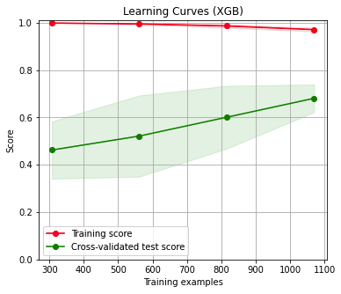
Summary and next steps
Next steps
Next steps
The model has revealed pricing patterns in the skincare market with it being able to predict product affordability with 76% accuracy
This confirmed some initial hypothesis (i.e. brands are able to charge more for targeting certain skincare concerns and offering better formulation types like serums) and also disproved others (i.e. there is a premium paid for award-winning products, ‘clean’, cruelty-free or vegan products)
The brand of the product is relatively less important for pricing (vs. other features) with certain exceptions (i.e. The Ordinary, Inkeylist, Dr. Barbara Sturm)
Ratings matter more for expensive products
Some ‘mispricing’ of products can be found following the results of the model
Model deployment already in progress
Model can be improved further by expanding the training dataset, as shown by the learning curve
Findings can be supplemented by consulting domain experts regarding ingredient use

Slide 18
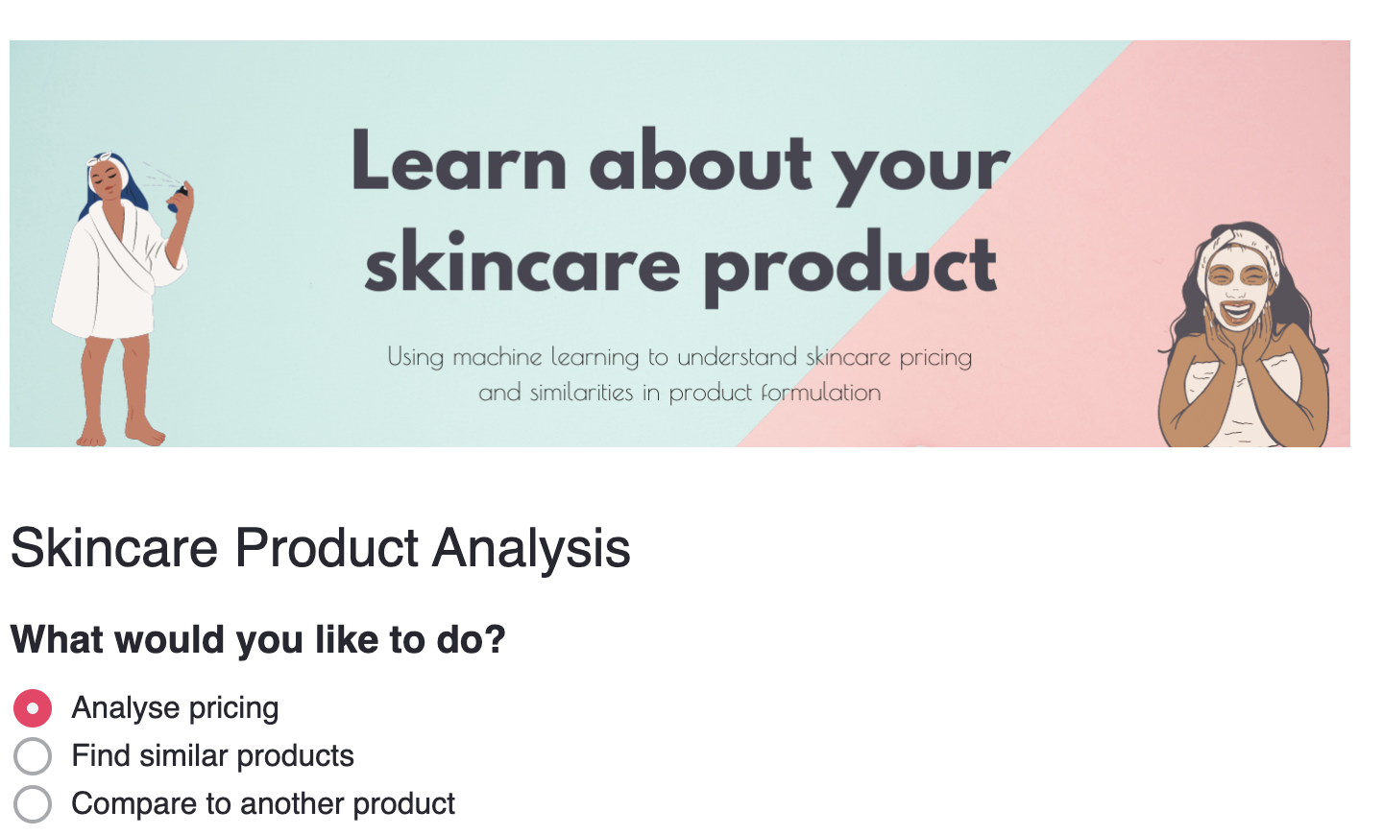
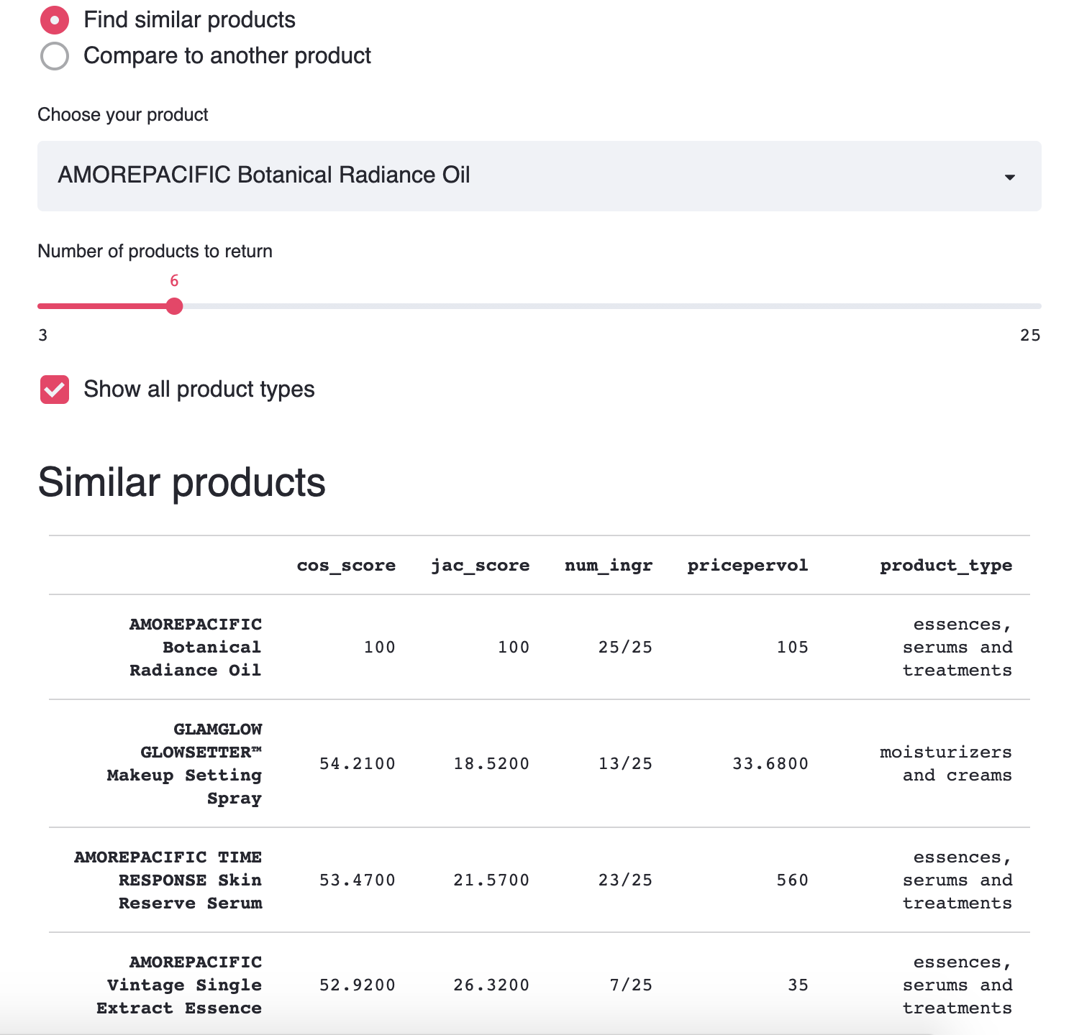
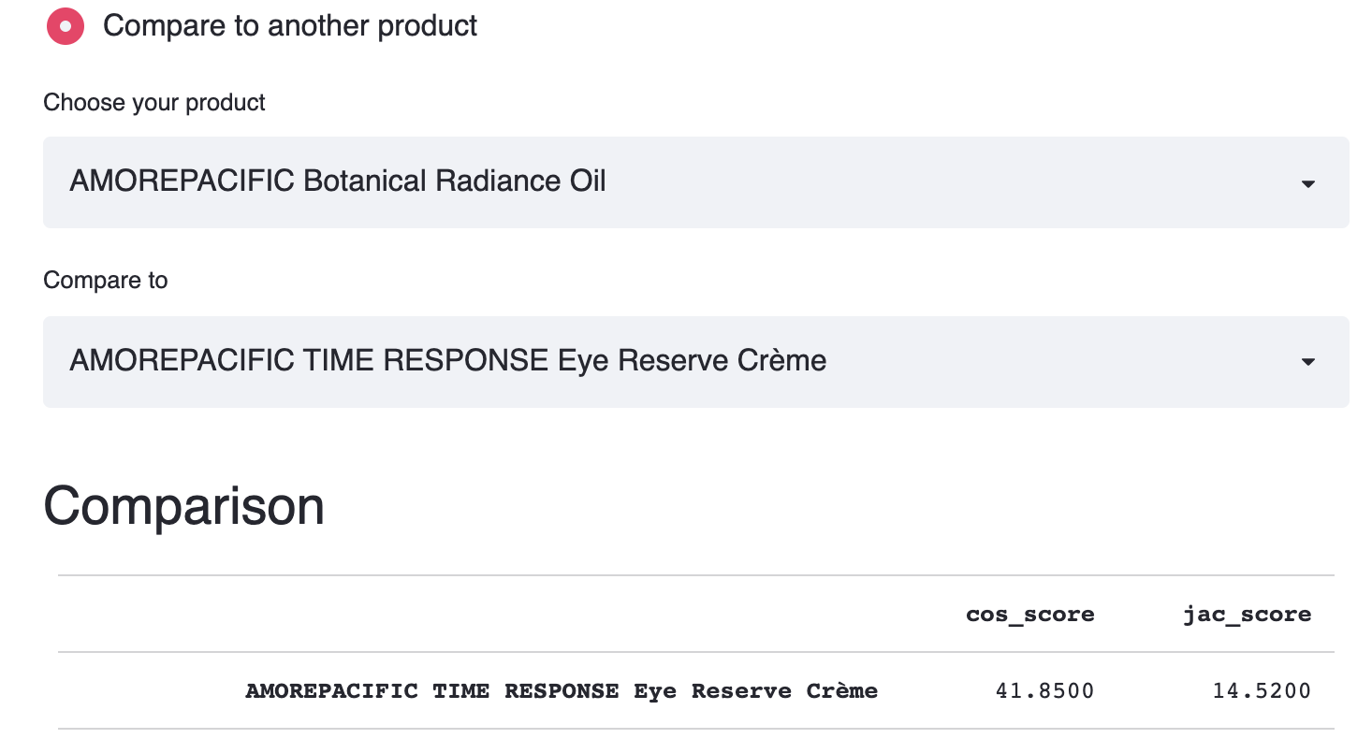
Model deployment
Possible use cases
Manufacturers
Gain insights into how the market prices its products
Establish the competitiveness of its products in terms of pricing
Provide a range estimate for new products
Inform product formulation
Find closest competitors
Consumers
Determine whether the product is ‘fairly’ priced
Starting point to learn about what makes the product cheap or expensive
Discover new products by finding closest alternatives based on ingredient/formulation similarity
Provide a tool to compare a product against another based on ingredients used

Slide 19
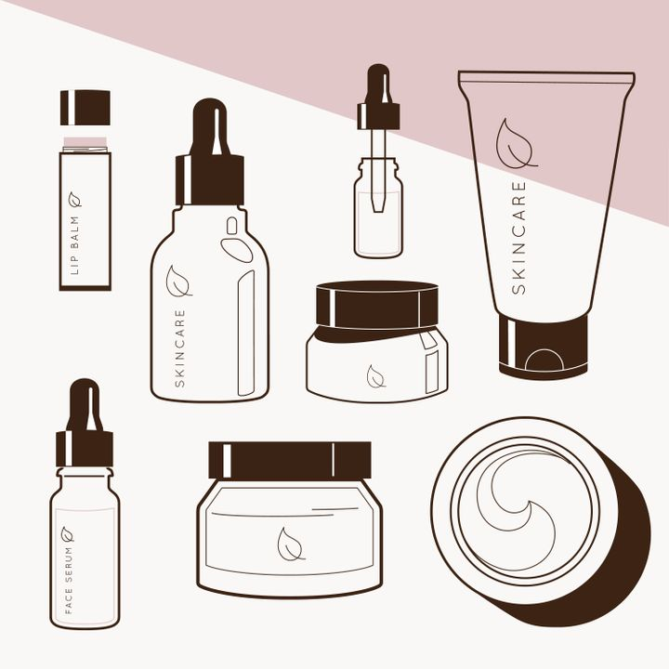
www.streamlit.io – to update
Any comment or suggestion?
Feel free to connect with me!
Email: amurao.frances@gmail.com
LinkedIn: linkedin.com/in/nikki-amurao/

Slide 20
Appendix

Slide 21
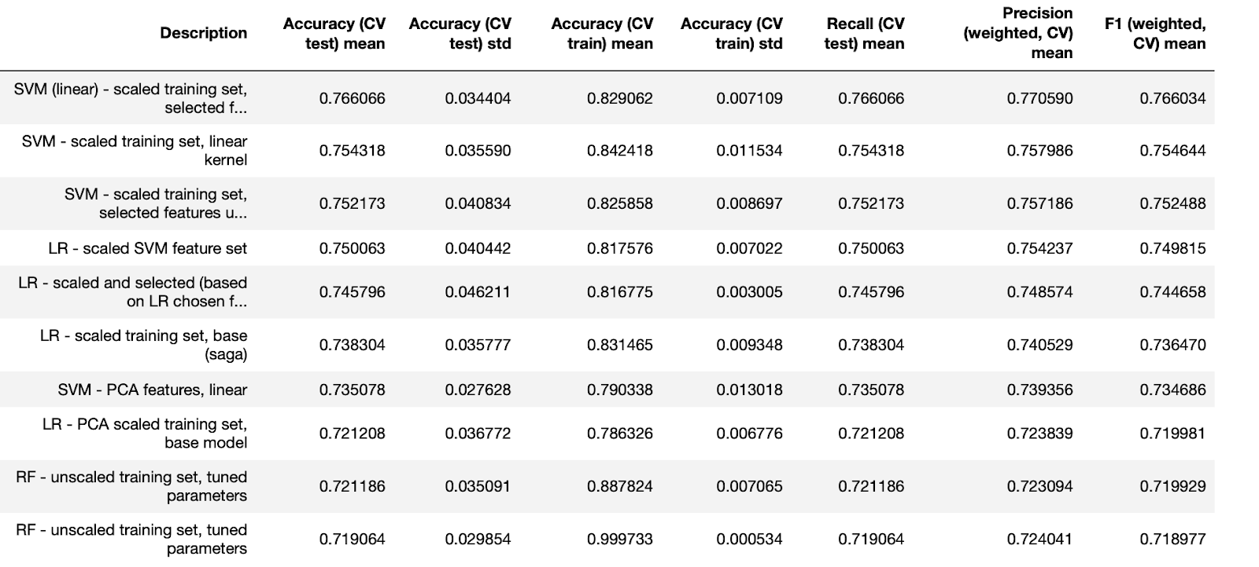
Performance comparison

Slide 22
SHAP values

Slide 23
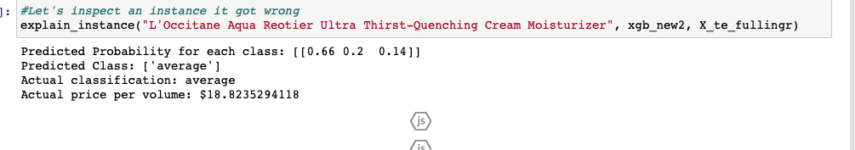
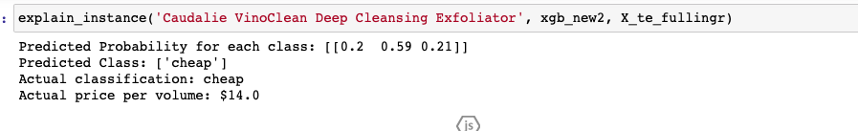
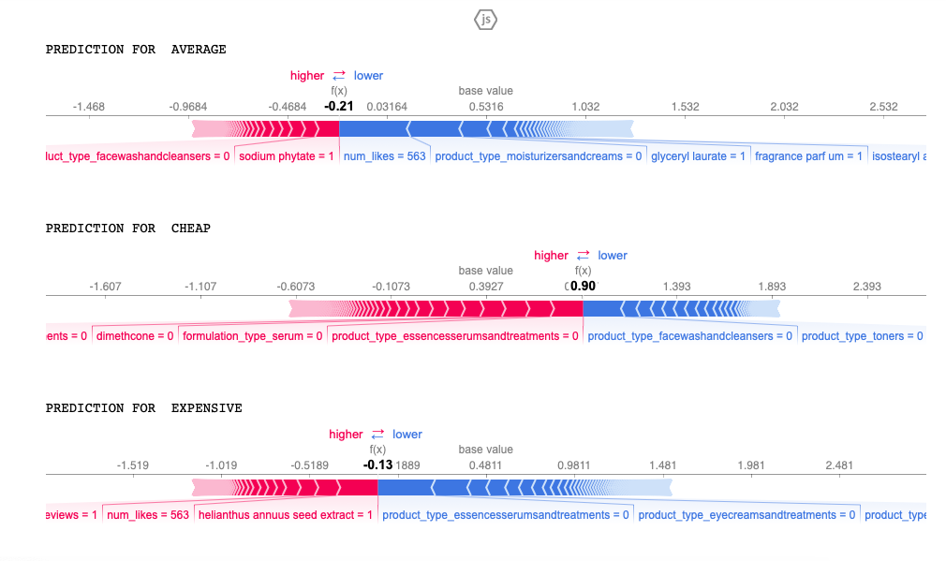
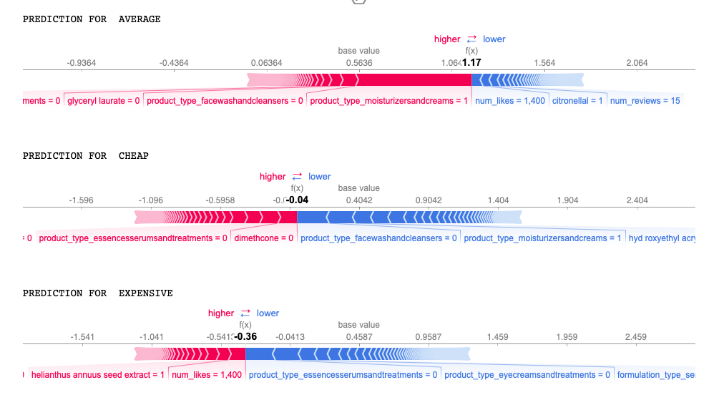
Model predictions

Slide 24
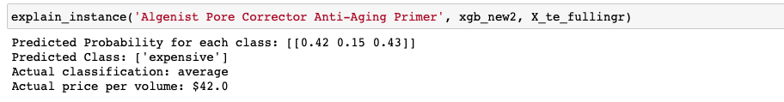
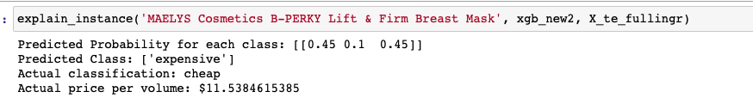
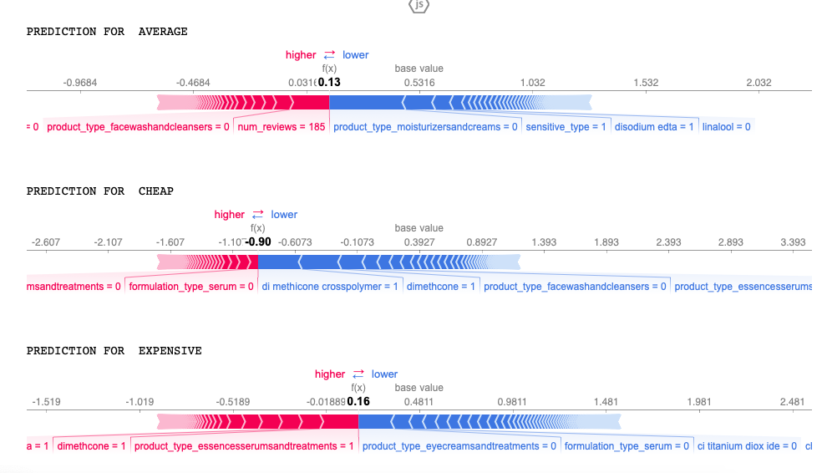
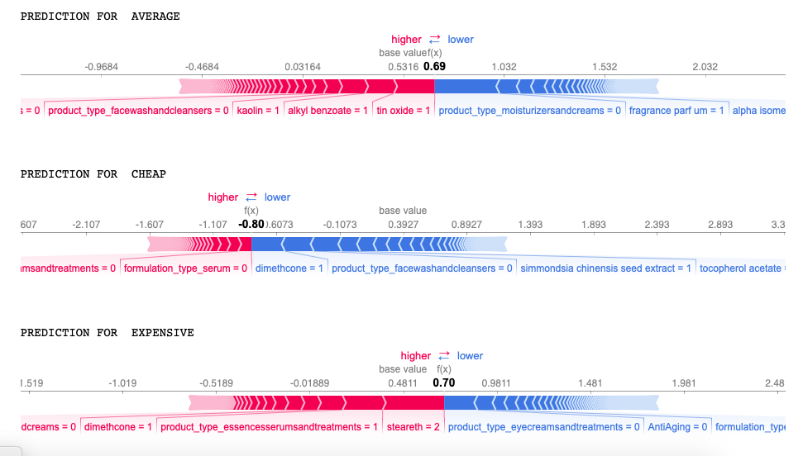
Model mistakes

Slide 25
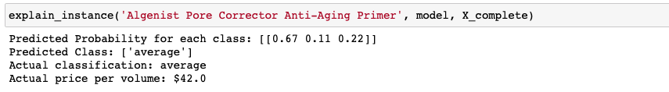
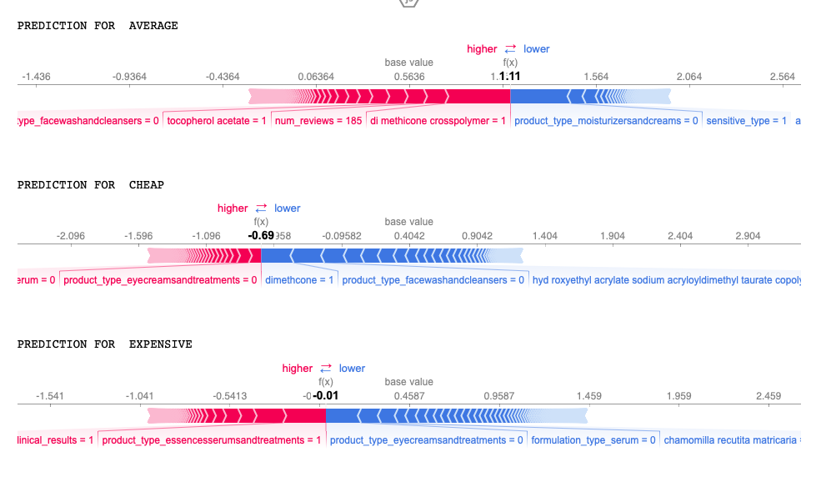
Model improvement after retraining on full complete dataset

